Slide 1
Database INDEXING
Radhika Rani Chintala

Slide 2
Session Contents
What is Index / Indexing?
Why we need Index / Indexing?
What is Index in Databases?
Different types of Indexing
Importance of Indexing

Slide 3

What is Indexing ?
INDEXING is a data structure technique which allows you to quickly retrieve records from a database file.

Slide 4

Why Indexing is used?

Slide 5
?

Slide 6
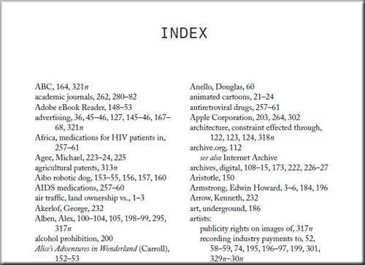
Indexes are used to quickly locate data without having to search every record in multiple disk blocks Similar to Indexing in Textbooks

Slide 7
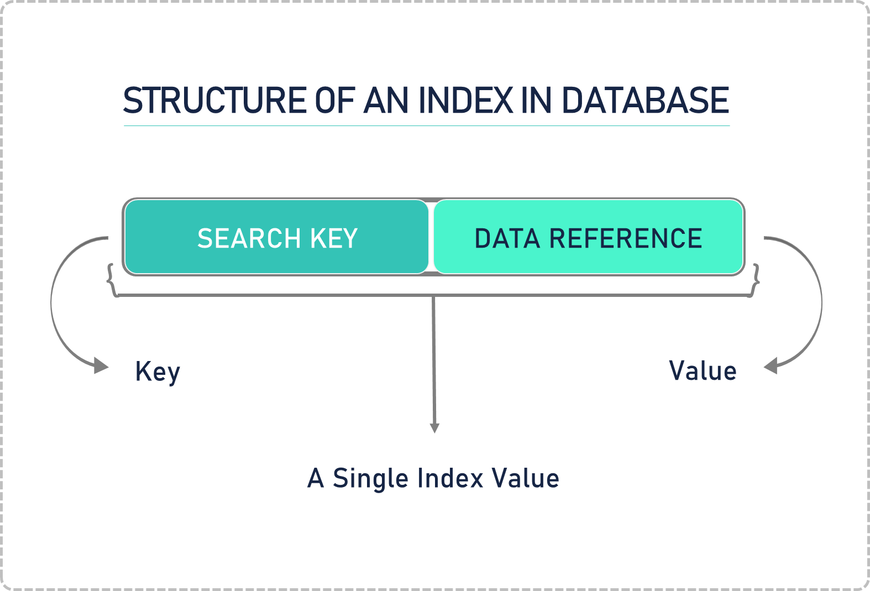
What is Index in Databases ?
An Index is a small table having only two columns. The first column comprises a copy of the primary or candidate key of a table. Its second column contains a set of pointers for holding the address of the disk block where that specific key value stored.
An index -
Takes a search key as input
Efficiently returns a collection of matching records.

Slide 8
Types of Indexing
Indexing
Primary Indexing
Dense
Sparse
Clustered Indexing
Secondary Indexing
Multilevel Indexing

Slide 9
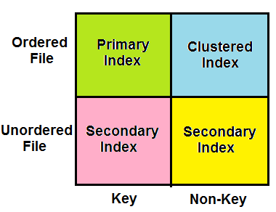
Which Indexing method is used ?

Slide 10
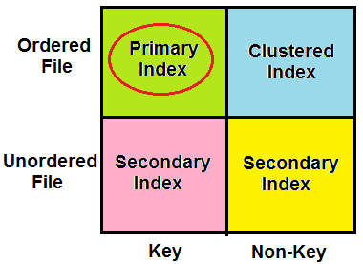
Primary Indexing
Primary Index is an ordered file which is of fixed length size with two fields.
The first field is the same a primary key and second field is a pointer that points to that specific data block.
The primary Indexing is further divided into two types.
Dense Index
Sparse Index

Slide 11
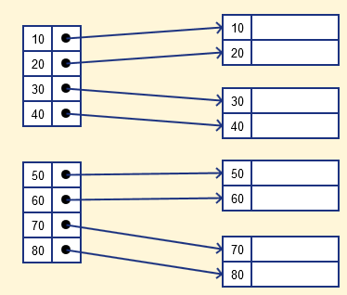
Dense Index
A record is created for each search key valued in the database.
Searching is faster
Requires more space to store index records
No. of records in IT = No. of records in HD

Slide 12
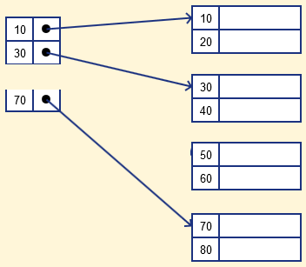
Sparse Index
Sparse index contains only the anchor records
To locate a record, we find the index record with the largest search key value <= search key value we are looking for.
We start at that record pointed to by the index record, and proceed along with the pointers in the file (sequentially) until we find the desired record.
No. of records in IT = No. of blocks in HD
Time Complexity = log2N + 1

Slide 13
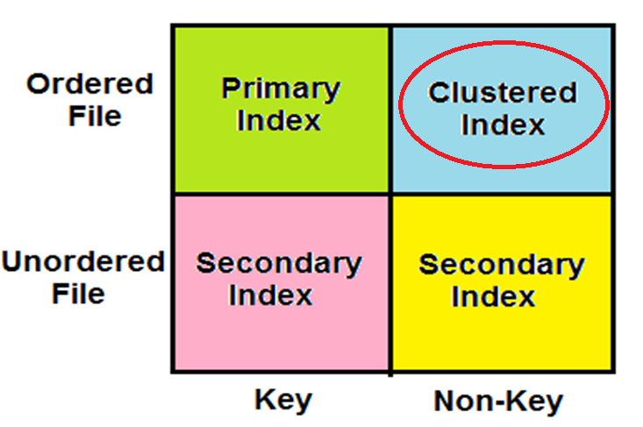
Clustered Indexing
Clustering index is defined on an ordered data file. The data file is ordered on a non-key field.
In some cases, the index is created on non-primary key columns which may not be unique for each record.
In such cases, in order to identify the records faster, we will group two or more columns together to get the unique values and create index out of them. This method is known as the clustering index.
Basically, records with similar characteristics are grouped together and indexes are created for these groups.

Slide 14
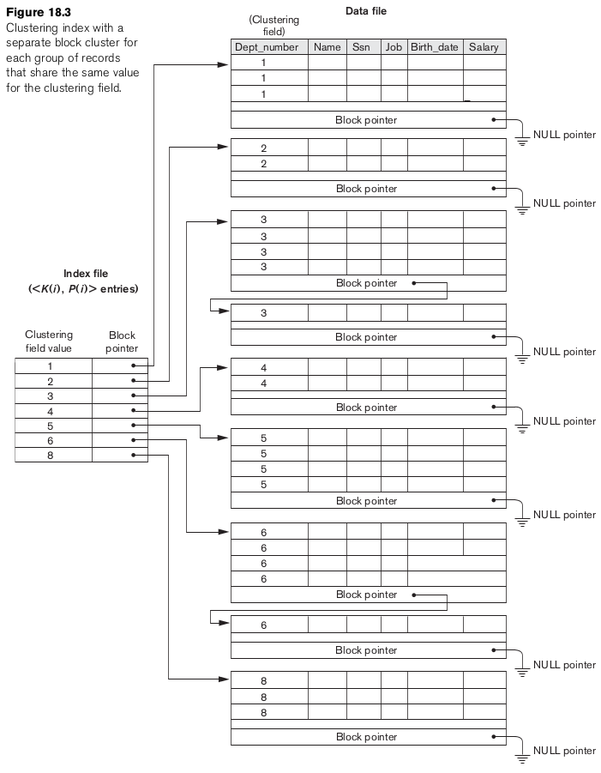
Contains block pointer which points to the next block data with the same clustering field value. Searching criteria is little bit increased. Uses Sparse index
Time Complexity = log2N + 1 + 1..

Slide 15
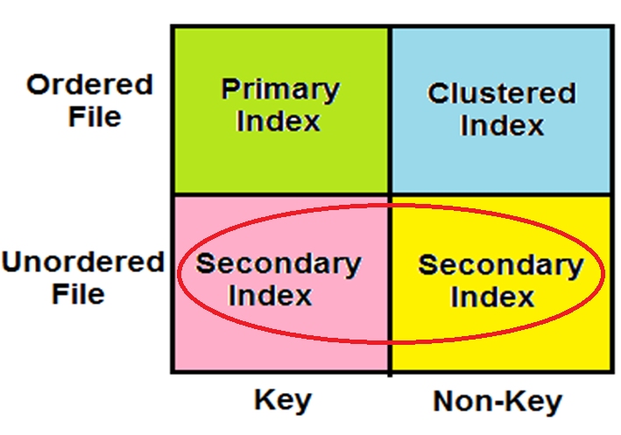
Secondary Indexing

Slide 16
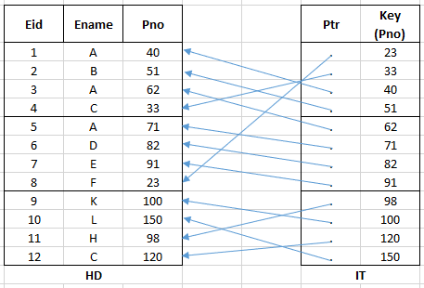
Unordered file with secondary key
Secondary Index Example
File is ordered on Eid(Primary Key)
Search to be done using Pno
So, Index table will maintain Pno as a key and in ordered.
Time Complexity = log2N + 1

Slide 17
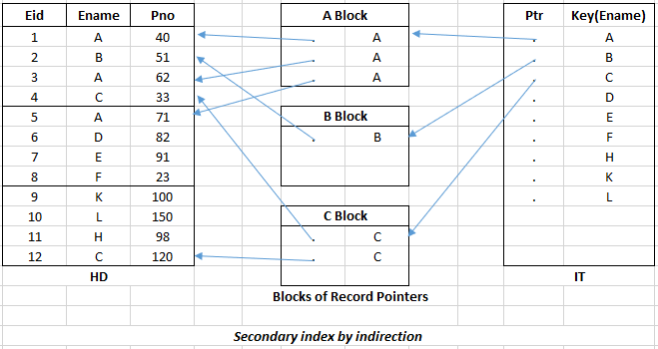
Unordered file with Non-key
Secondary Index Example
Search done by Ename(Non-key)
Index file contains Ename as key and is ordered.
Maintains intermediate index layer which contains block of record pointers.
Pointer in IT points to a particular block and the record pointers in that block will point to the record in HD.
Time Complexity = log2N + 1 + 1

Slide 18
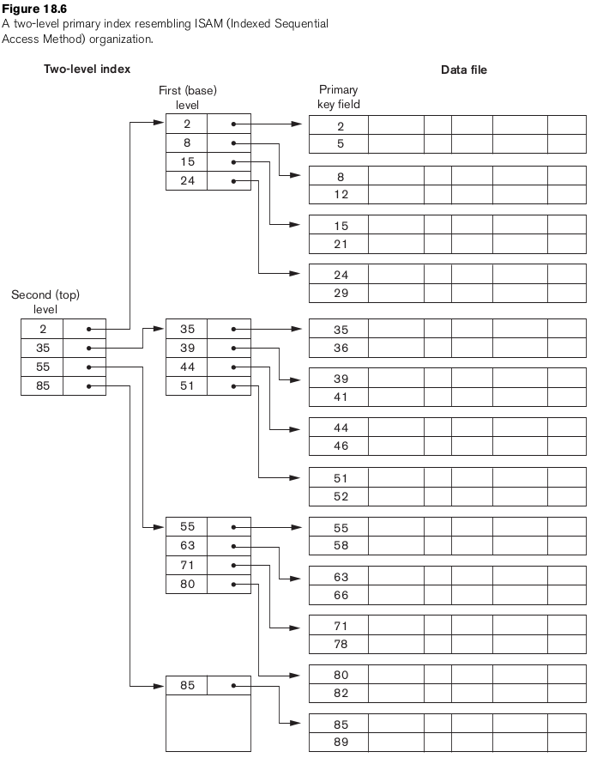
Multilevel Indexing Creating an index on the index

Slide 19
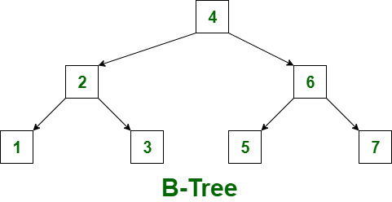
Dynamic Multilevel Indexing using B-Trees & B+ Trees
Balanced Tree
In multilevel indexing, inserting and deleting a record is difficult, as the corresponding entries in index tables also need to be changed.
B-Trees makes these tasks simple.
Elements are in sorted order

Slide 20
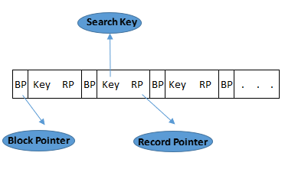
B-Tree
A B tree of order m contains the following properties:
Every node in a B-Tree contains at most m-1 keys and m children.
Every node in a B-Tree except the root node and the leaf node contain at least m/2 children.
The root nodes must have at least 2 nodes.
All leaf nodes must be at the same level.
It is not necessary that, all the nodes contain the same number of children but, each node must have m/2 number of nodes.

Slide 21
B-Tree Example
B-Tree Example.docx
Insertion
Search
Deletion

Slide 22
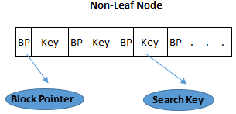
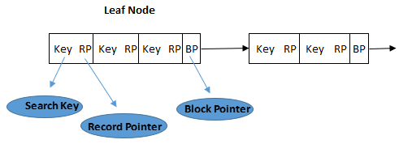
B+ Tree
B+ Tree is an extension of B Tree which allows efficient insertion, deletion and search operations.
In B Tree, records (data) can only be stored on the leaf nodes while internal nodes can only store the key values.
The leaf nodes of a B+ tree are linked together in the form of a singly linked lists to make the search queries more efficient.

Slide 23
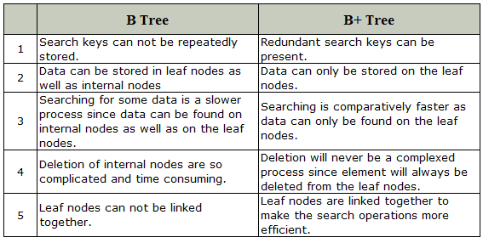
Difference between B Tree and B+ Tree

Slide 24
Construct B+ tree of order 3 for the following elements. 5, 9, 1, 10, 12, 13, 2, 3, 4
B+ Tree Example

Slide 25
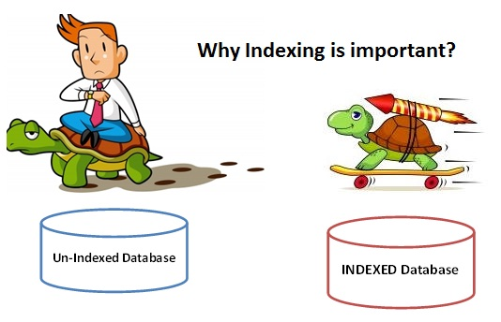

Slide 26

THE END

